Slide 1
Building a data pipeline using Raspberry Pi and Azure IoT services

Slide 2
Procedure to connect the Raspberry Pi to your Wi-Fi network via Ethernet
RJ45 Ethernet cable is used to establish the connection between the Raspberry Pi and the computer.
Step 1: Open “Network and Sharing center”.
Step 2: Click “Wireless network connection status”.
Step 3: Properties > Sharing.
Step 4: The option “Allow other network users to connect through this computer’s internet connection” is selected. This allows the Pi to detect the internet. This means that the Pi will be allotted an IP address.
Step 5: The Raspberry Pi can now be connected to the computer using the Ethernet cable.
Step 6: Click “Unidentified Network” Local Area Connection when it is detected and select “Properties”.
Step 7: Double click on Internet Protocol Version 4. Gateway IP of the new network is seen here.
Step 8: To know the IP allotted to the Pi, “Advanced IP Scanner” software is used. The software displays the name of the Pi and the IP allotted to it.

Slide 3
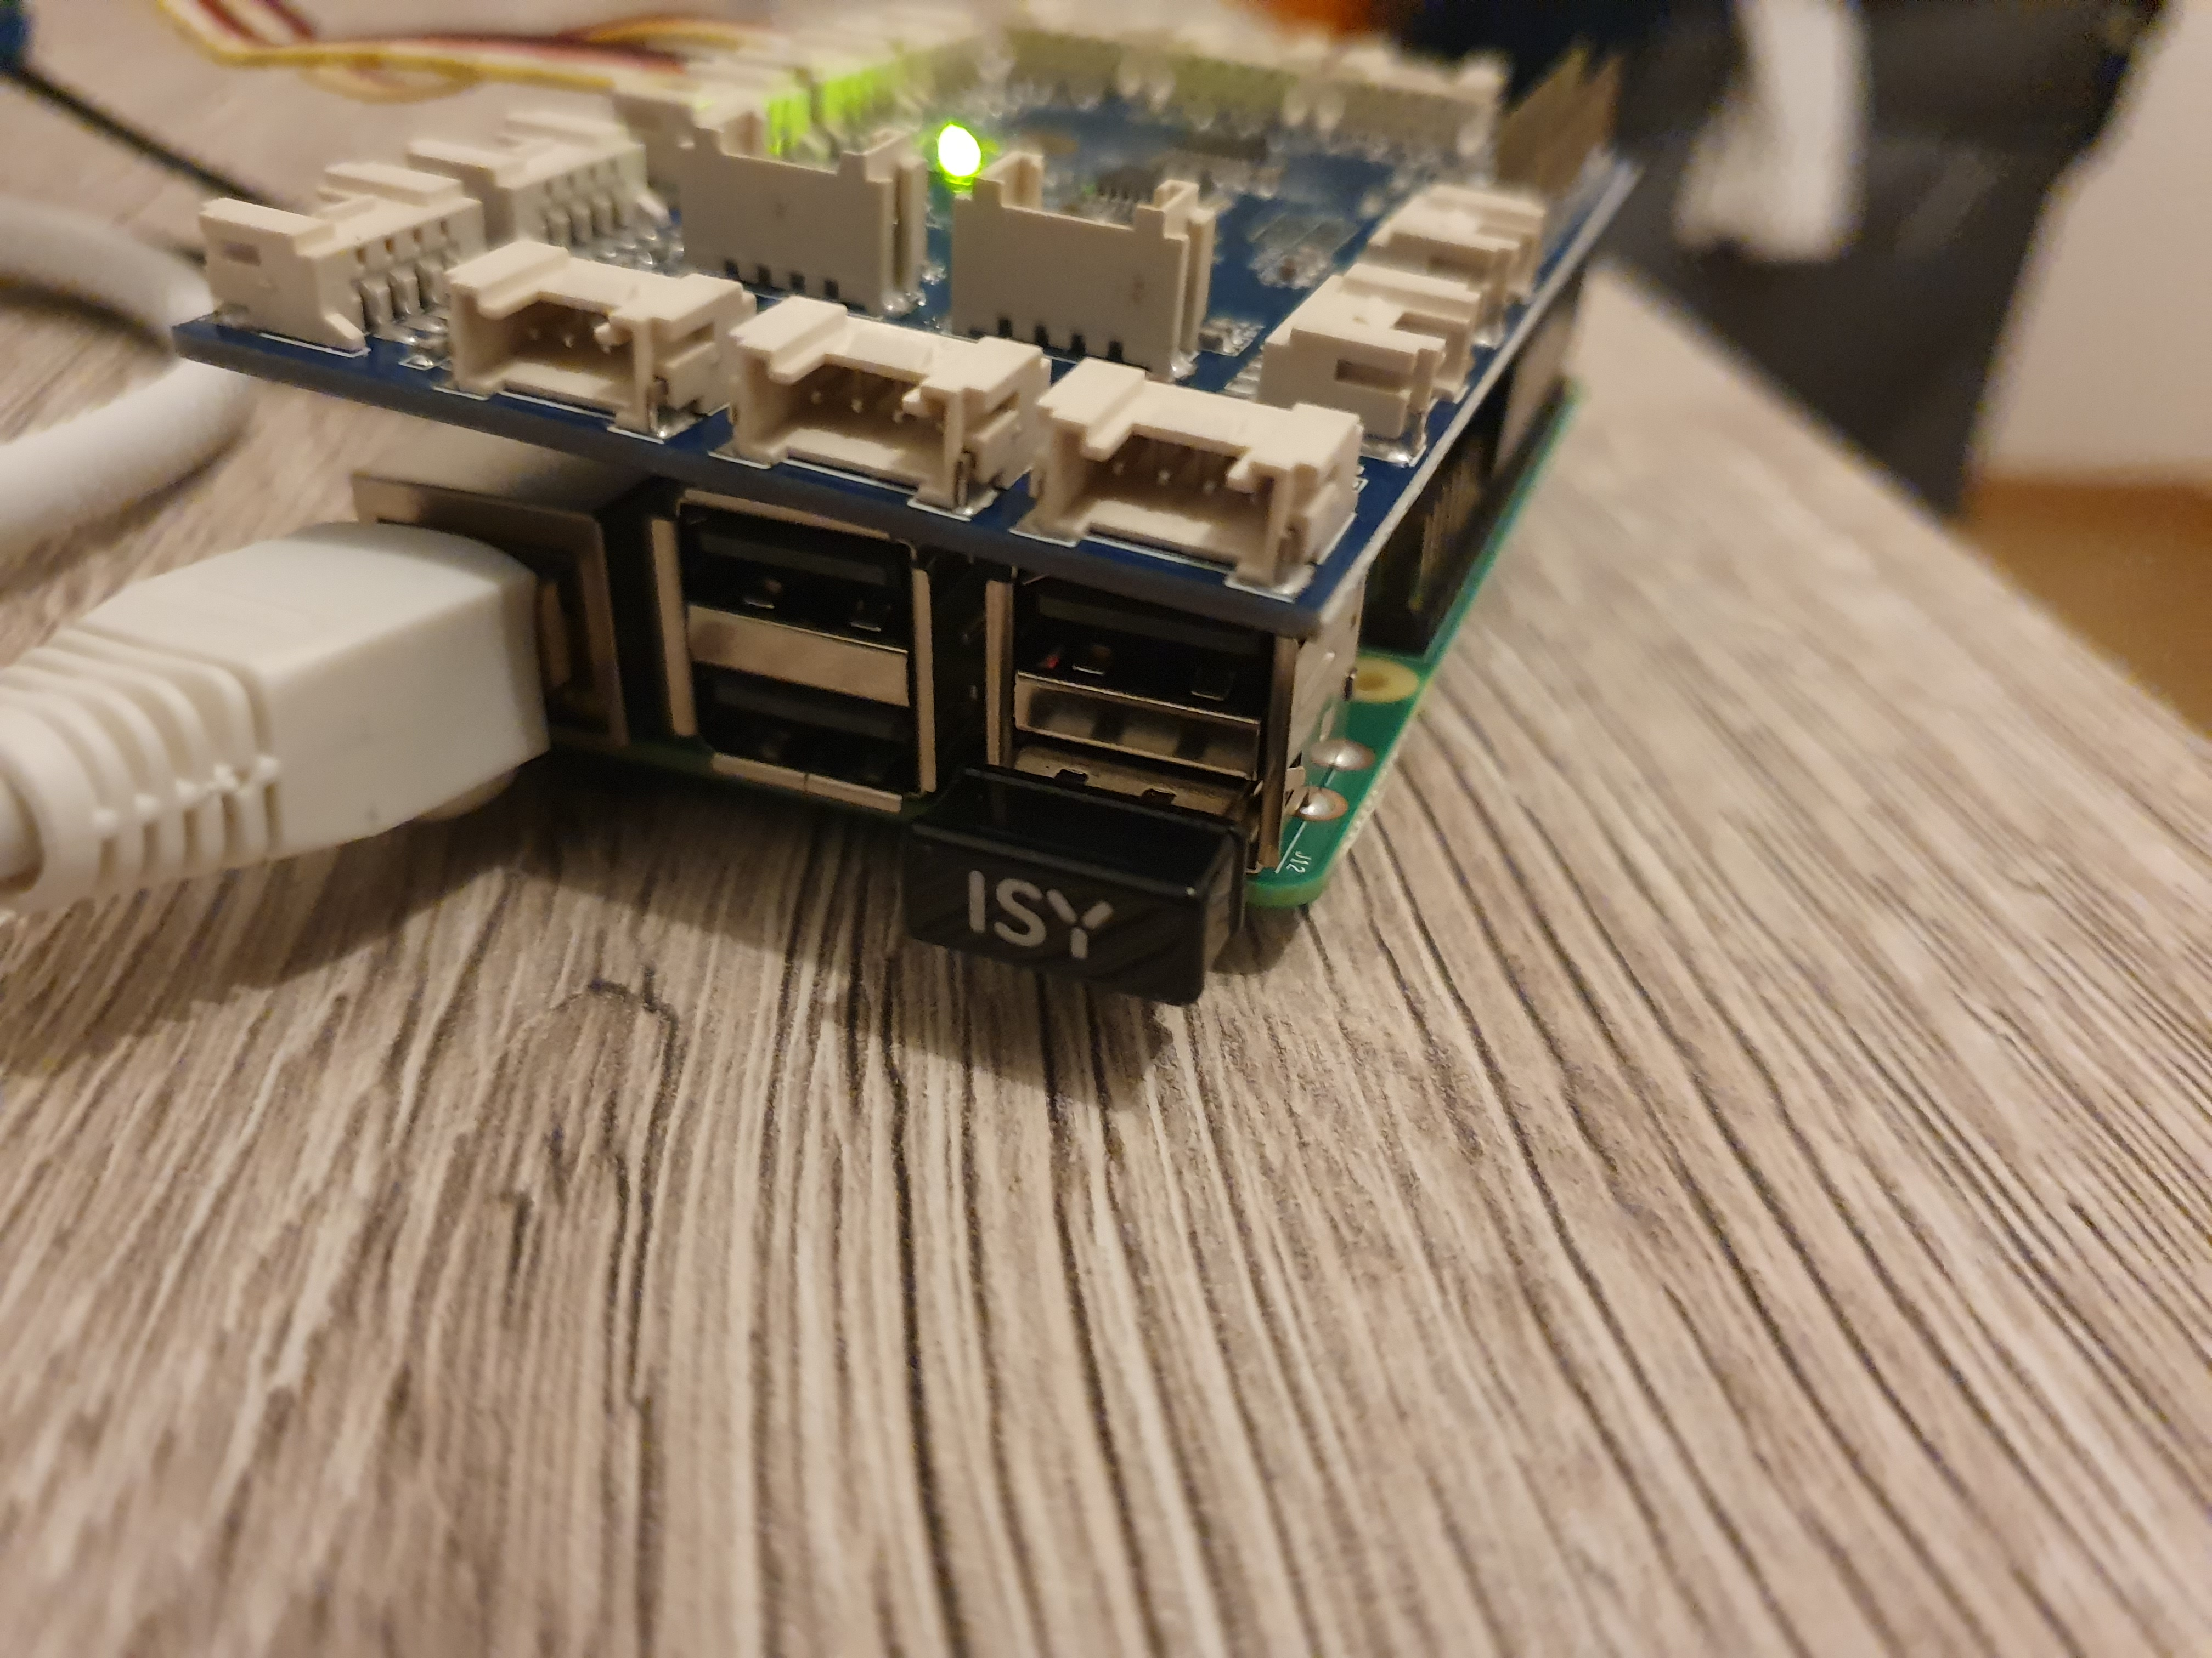
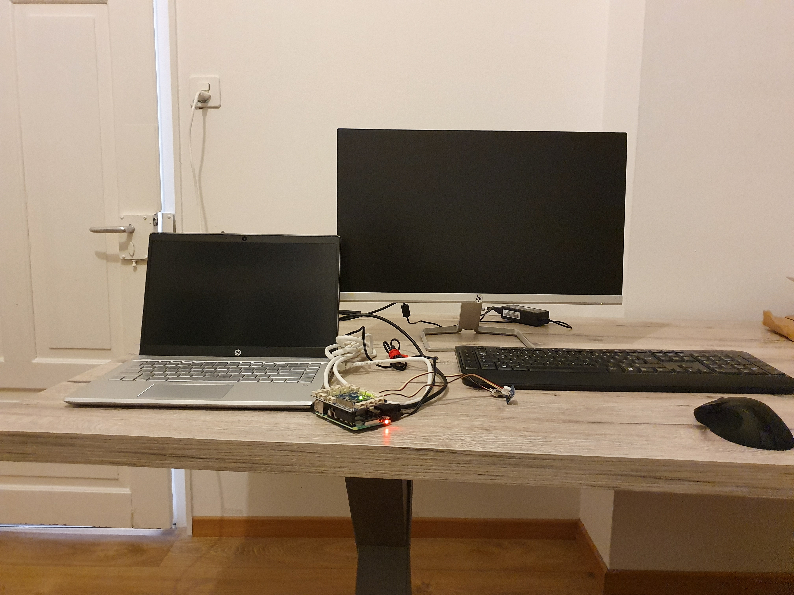
Edge Device setup
The RJ45 cable and a USB mouse-keyboard is plugged in.

Slide 4
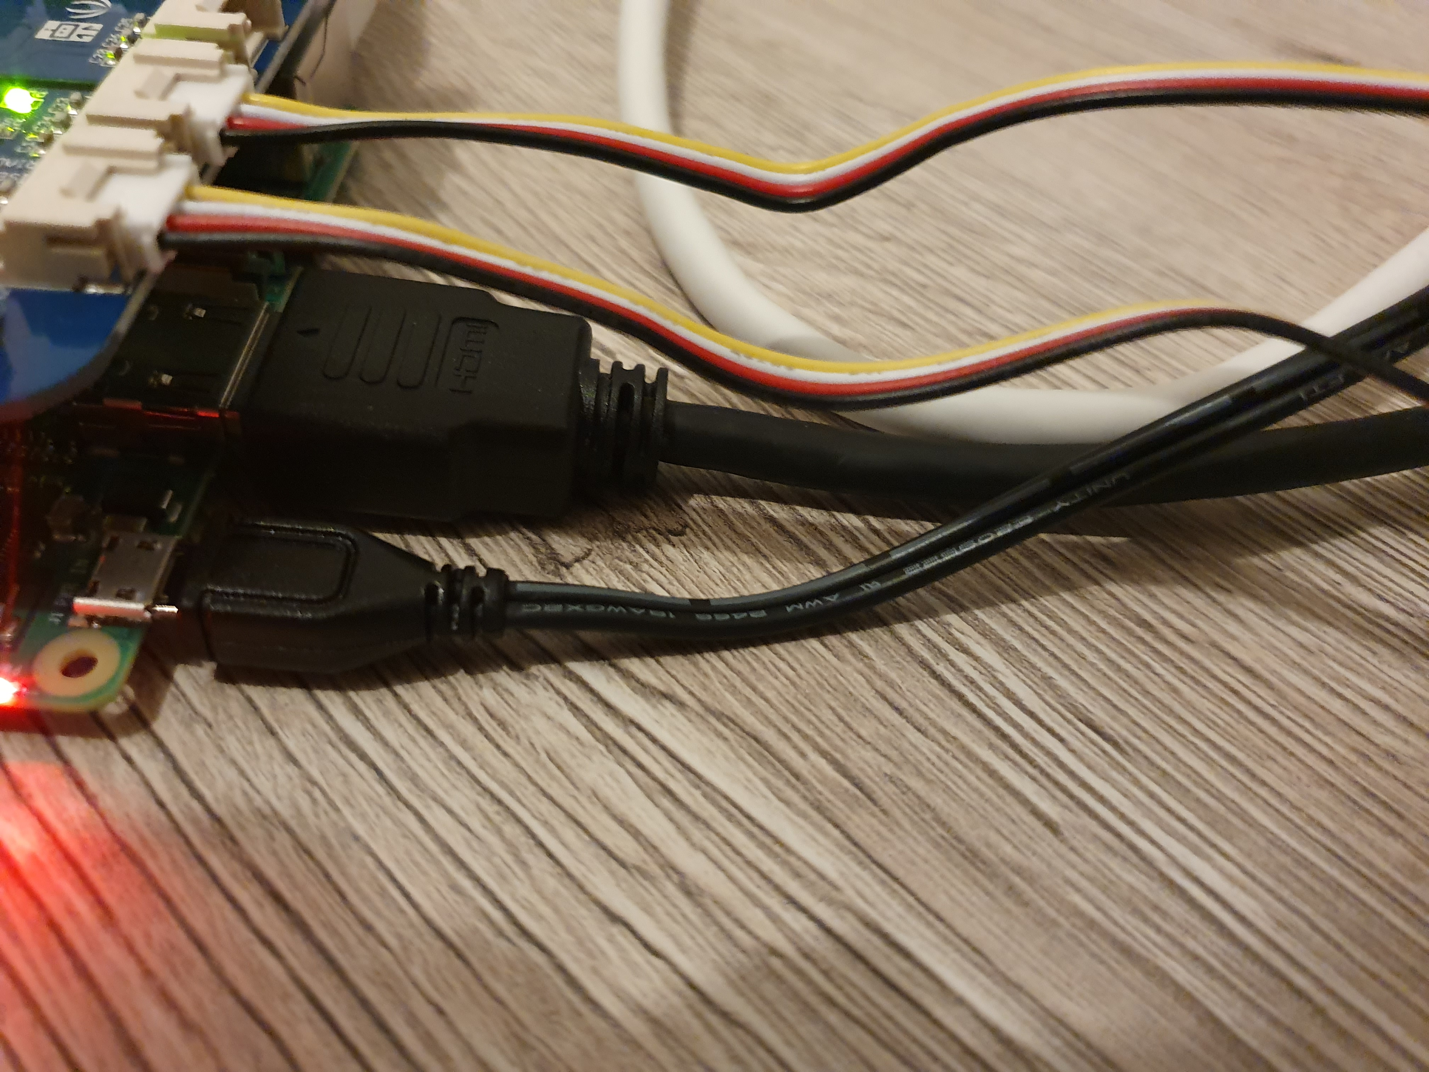
The power supply to the Pi is through Micro USB.
HDMI cable is plugged in to the port for establishing a display on external monitor.

Slide 5
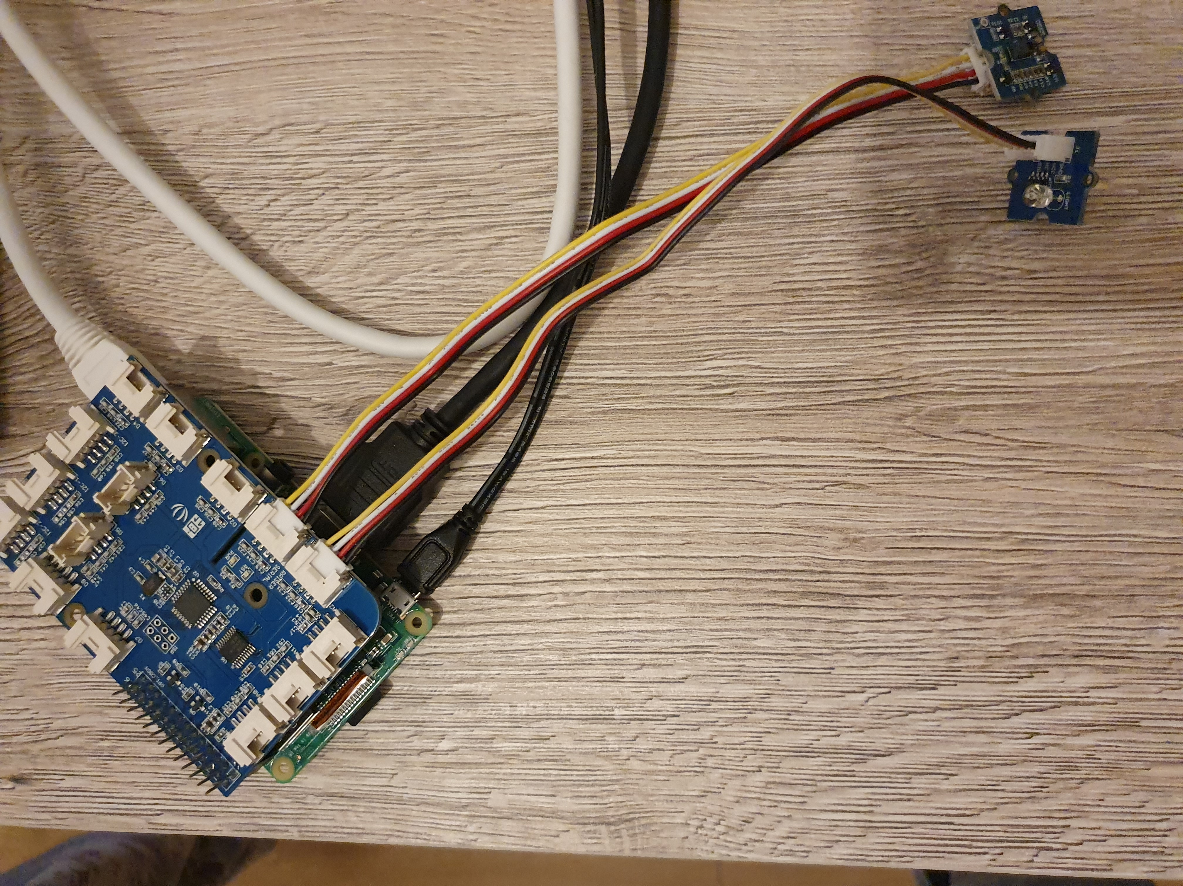
I have connected 2 sensors here.
A light sensor and a gesture sensor.
The Grove interface board allows easy connection of Multiple sensors to the Pi. It helps the user overcome the problem of limited GPIO pins on the Pi.

Slide 6
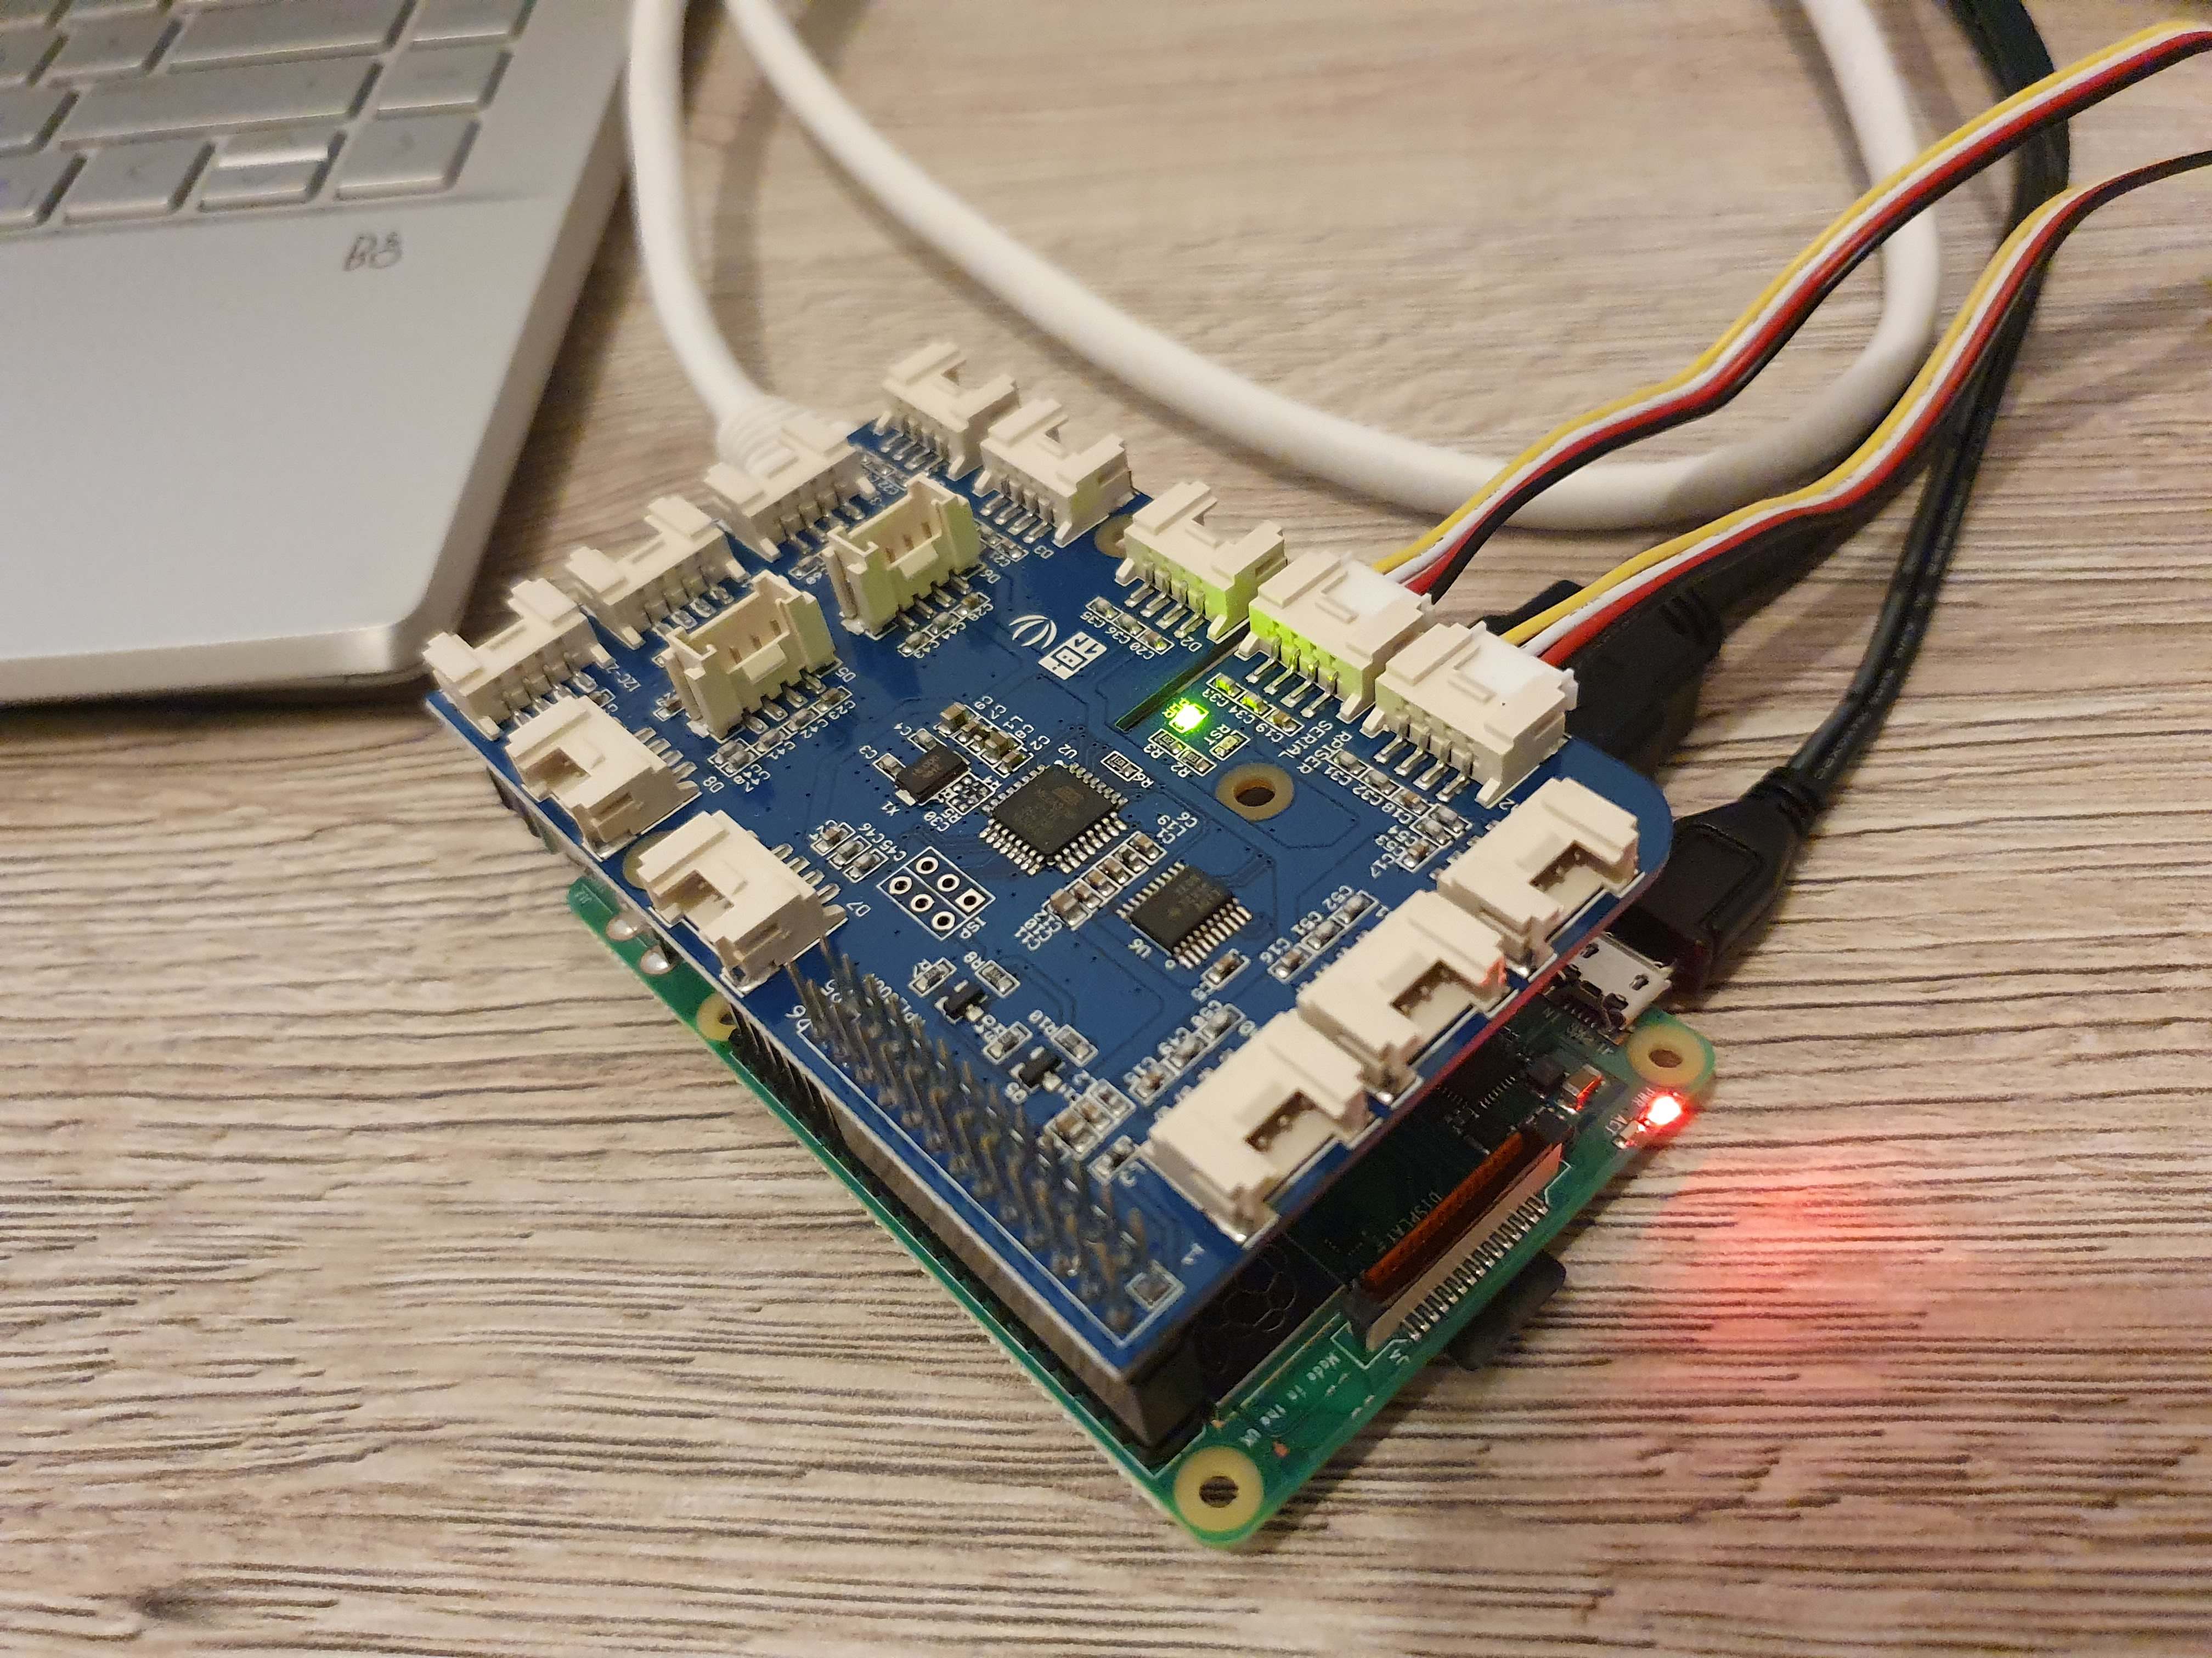
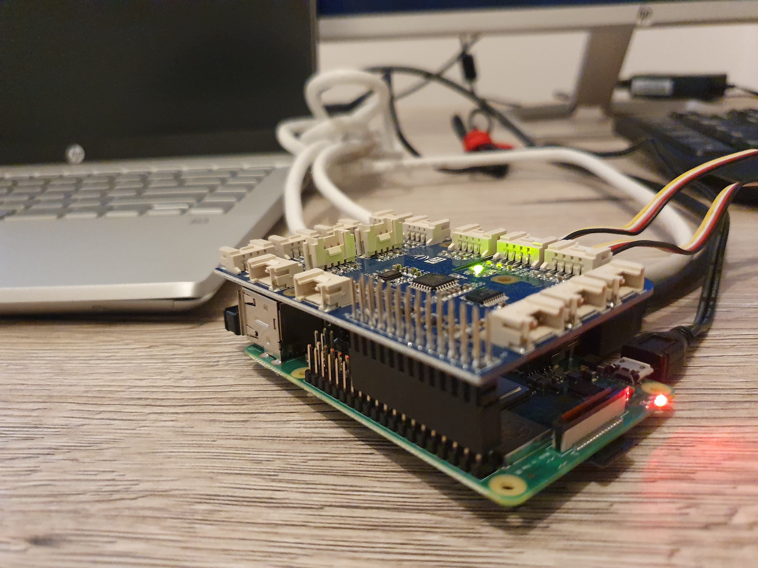
The Grove interface board/hook-up board is mounted on the Raspberry Pi.

Slide 7


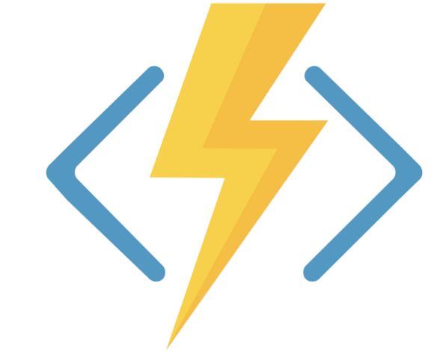
Pipeline I plan to build to link the Pi with Azure resources
(Via Azure CLI
running inside Docker on the Pi)
Data ingestion with stream analytics
Push event with C# Event Hub Trigger
Write Sensor values to Azure Table storage
Edge Device with Sensors

